Slide 1
Low Head Dam Detection using Deep Learning techniques
Rajeni Nagarajan
Sindhuja Madishetty
Taraka Srikrishna Kantipudi
Yamini Sri Vandana Penamakuru

Slide 2
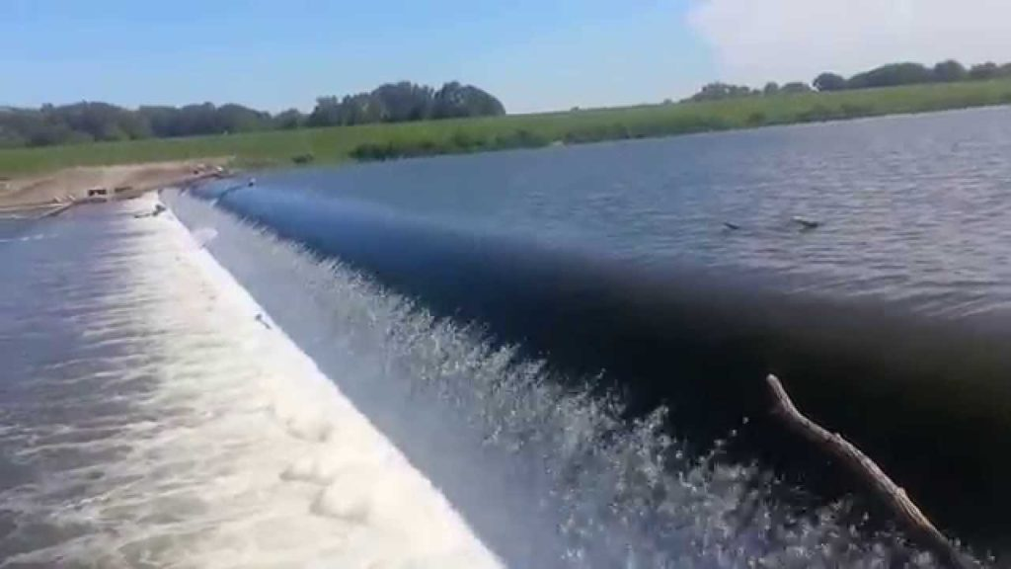
What is a low-head dam?
Low head dams are small structures that impounds a small amount of water and spans the width of the river.
Low head dams are built into and across the river channels for the purpose of diverting water from streams.

Slide 3
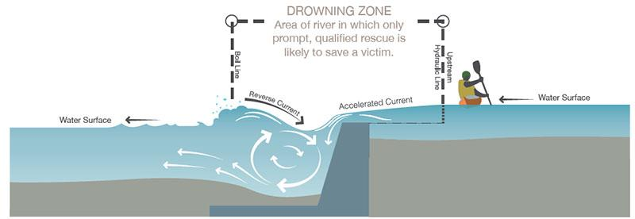
Problem Description
Low-head dams pose a serious danger to river users like Kayakers, rafters and swimmers. Surface currents below low-head dams can suck vessels toward the face of the dam. Currents above low-head dams can sweep vessels over the dam. The recirculating currents and turbulent waters below these dams can swamp vessels and drown boaters.
To address this problem, the Polis center came up with an idea of detecting low head dams using deep learning techniques.
Goal of this project - To detect the presence of low-head dams using the given satellite images

Slide 4
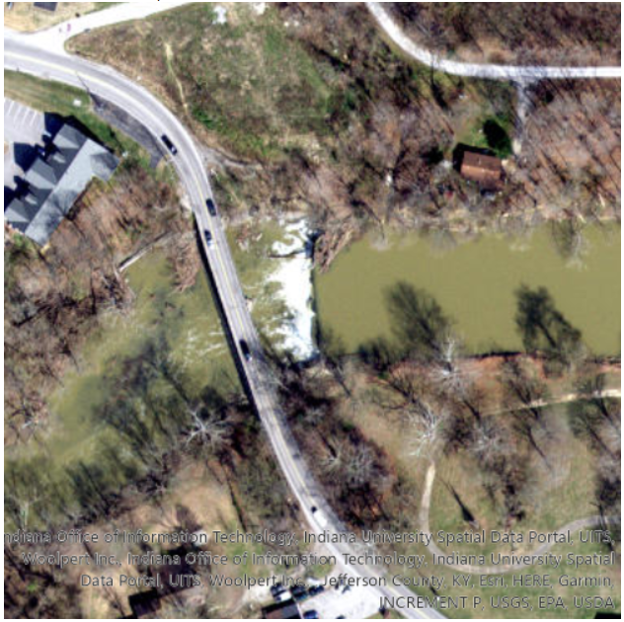
Dataset
Received this dataset from the Polis center (IUPUI)
Dataset - A total of 341 satellite images of dams/no-dams in Indiana with-
162 low-head dam images
179 no dam images
Image size- 500x500x3
Image format - PNG
Data split : 80% train and 20% test set
Train set : 273 images with 130 low-head dams and 143 no dams images
Test set : 68 images with 32 low-head dams and 36 no dams images

Slide 5
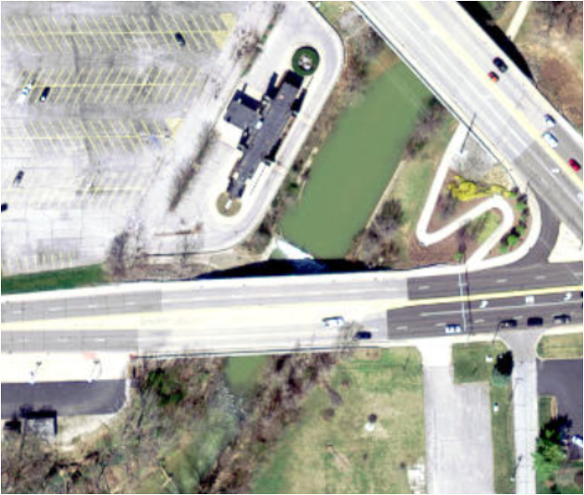
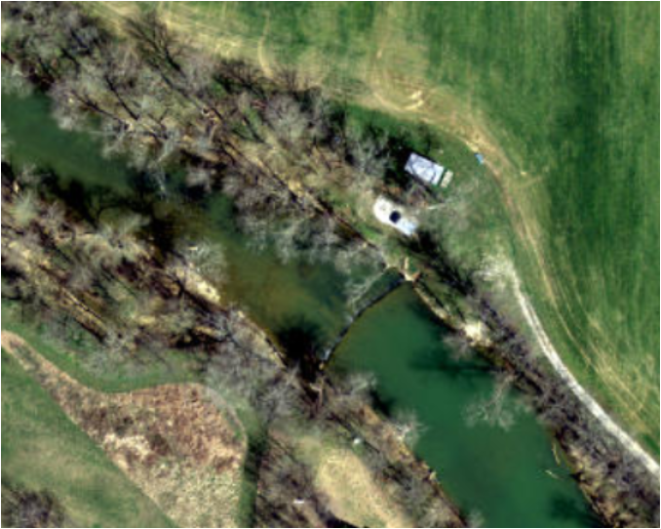
Challenges
No known pre-trained models to apply on satellite images of river dams.
Difficulty in identifying low-head dams in few samples manually.
Limited number of data samples to train the model.
Resolved by data augmentation techniques

Slide 6
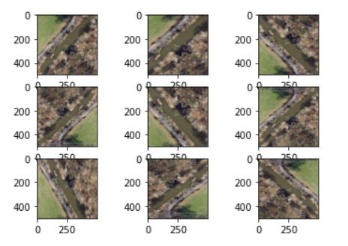
Data Augmentation
Technique that increases sample size of dataset by creating variations in existing images.
Keras - ImageDataGenerator
Transformations used
Rescale
Shear_range
Zoom_range
Horizontal Flip
Vertical flip
Generalizes the model well

Slide 7
Building the models
Number of layers - Convolution and Deep
Filters and Kernel sizes
Valid and same padding, padding filters and stride sizes
Average and Max Pooling for pooling layers
Activation functions - relu, tanh
Batch size - 16, 32, 64
Regularization - dropout
Batch Normalization
Optimizers - Adam, RMSProp, SGD
Epochs
Learning rate - (0.001, 0.00075, 0.0001)

Slide 8
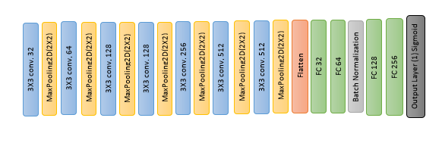
Final Model
7 Convolution layers, 4 Fully Connected layers
Relu activation function, sigmoid at the output layer
Batch size 32
20 epochs
Adam optimizer
Binary cross entropy loss
Metrics used for evaluation - Accuracy, Precision, Recall

Slide 9
Results
Model | Optimizer | Activation | Padding | Batch Size | Epochs | loss (test) | Training Accuracy | Test Accuracy | Precision (test) | Recall (test)
AlexNet | Adam | relu | valid | 32 | 20 | 2.05 | 0.85 | 0.78 | 0.80 | 0.78
VGG-19 | Adam | relu | same | 8 | 40 | 0.36 | 0.87 | 0.87 | 0.83 | 0.90
Model-3 | Adam | relu | same | 16 | 40 | 0.34 | 0.89 | 0.87 | 0.87 | 0.85
Model-4 | Adam | relu | same | 16 | 40 | 0.33 | 0.84 | 0.85 | 0.81 | 0.90
Final Model | Adam | relu | valid | 32 | 20 | 0.32 | 0.88 | 0.91 | 0.94 | 0.88

Slide 10
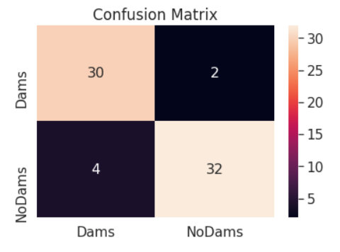
Confusion Matrix - Test Data

Slide 11
Future Scope
Ability to make the model differentiate between a low-head dam and high head dam.
Obtaining the location of the dams (latitude and longitude) for correctly predicted low-head dam images.

Slide 12
DISCUSSION : Q & A

